Slide 1
Atoms

Slide 2
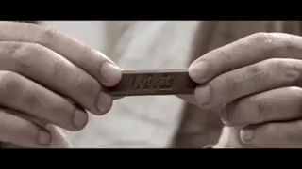
What's the smallest piece of matter that can exist?
Let's do a little thought experiment to find out.
Take a block of chocolate and break it in half. Then do it again, and again, and again...

Slide 3
If you continue to break the chocolate, you will eventually create a tiny crumb, but this crumb can still be broken into smaller pieces.
You need more and more advanced technology to continue to break the crumbs down.
Eventually though you will have to stop, because there is a limit to how you can divide matter with this method. This limit is the smallest unit of matter - the atom.

Slide 4
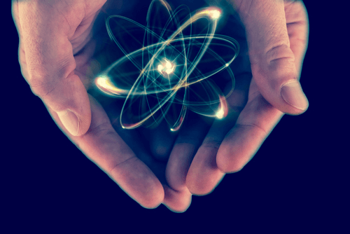
By the end of this Smart Lesson, you should be able to:
1. Understand that everything is made of atoms.
2. Name the three subatomic particles that make up all atoms.
3. Describe how these subatomic particles are arranged in each atom.

Slide 5
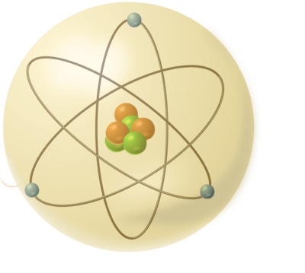
We usually model the atom as a sphere.
There are over 100 different types of atoms and each one has different properties.

Slide 6
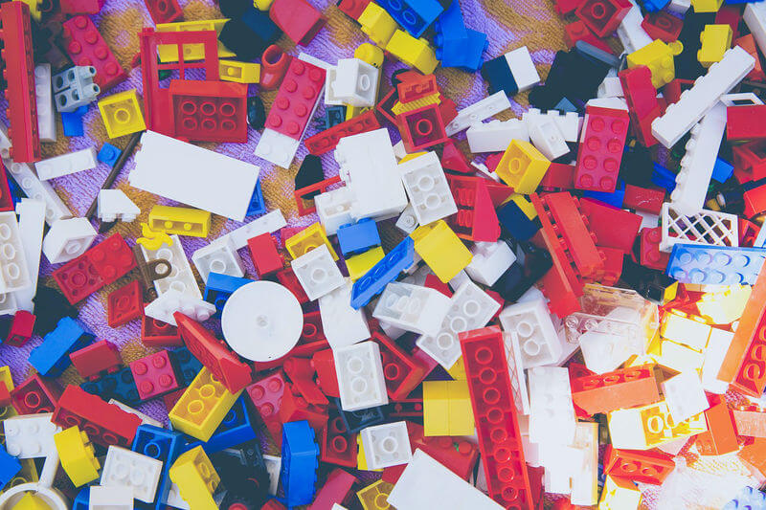
You can think of atoms as being like Lego - each different arrangement of atoms creates something new.
With different arrangements of atoms, you can make chocolate, a house, a horse, or even you!
We call atoms the building blocks of all matter.

Slide 7
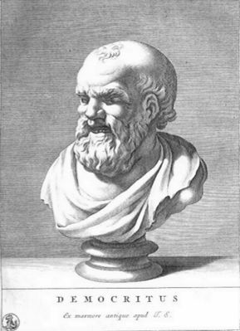
The concept of an atom was first proposed over 2500 years ago by the Greek philosopher Democritus.
He proposed that everything was made up of particles that were so small they were invisible to the naked eye. These particles were later named atoms from the Greek word atomos, meaning indivisible (unable to be split).

Slide 8
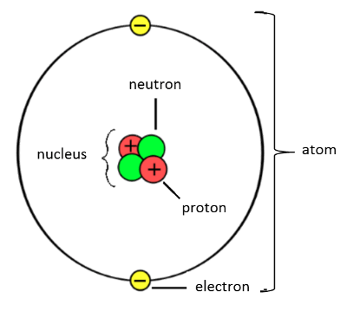
Nowadays, we know that atoms are composed of three subatomic particles.
Subatomic just means occurring within an atom. The three types of subatomic particles are: protons, neutrons and electrons.

Slide 9
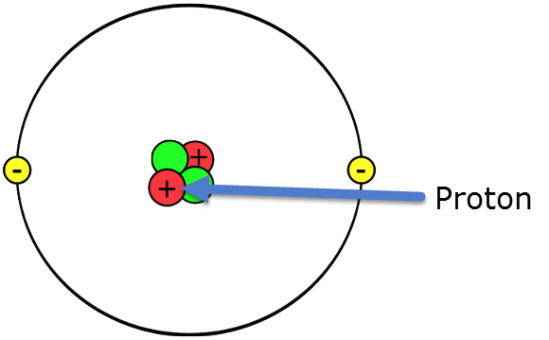
Protons were discovered by Ernest Rutherford, a New Zealand-born physicist.
Protons have a positive charge. They have a much larger mass than electrons, and are found in the nucleus (center) of the atom.

Slide 10
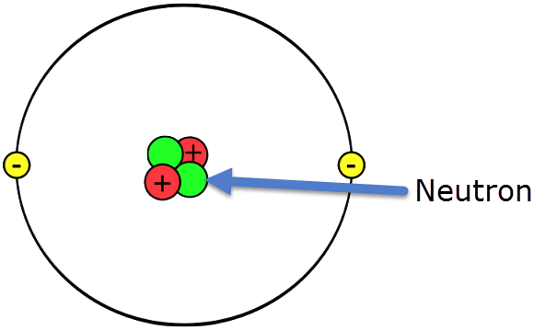
Neutrons are also found in the nucleus (centre) of the atom.
Neutrons have the same mass as protons and have a neutral charge.

Slide 11
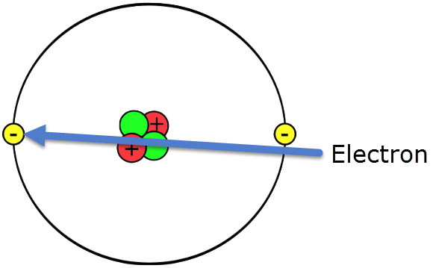
Electrons are the smallest subatomic particles.
They orbit very far from the nucleus. If the nucleus was the size of our Sun, the first electrons would be three times further away than Pluto!
Electrons are 1800 times lighter than protons and are negatively charged. Overall, atoms have a neutral charge, as they have the same amount of protons and electrons.

Slide 12
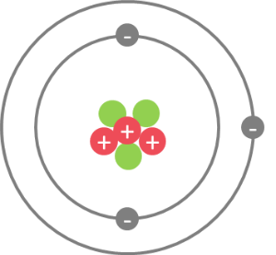
Electrons can only orbit at set distances from the nucleus.
The spaces where electrons orbit are known as electron shells. The first electron shell can hold 2 electrons. The second can hold 8 electrons. The third can hold 8 electrons as well!

Slide 13
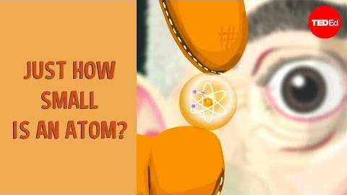
We know that atoms are tiny, but just how tiny are they?
This video (5:28) demonstrates just how small an atom is, how much smaller the nucleus is and how far away the electrons are.

Slide 14
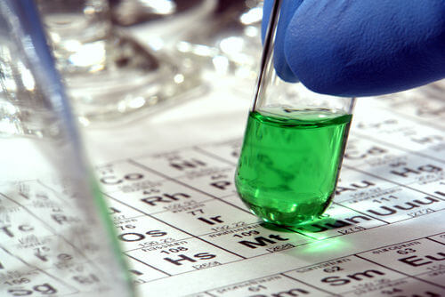
There are currently 118 known types of atoms.
These are known as the elements. Different combinations of these 118 atoms make up every known substance on Earth!

